Slide 1

MAHATMA EDUCATION SOCIETY’S PILLAI COLLEGE OF ENGINEERING, PANVEL DEPARTMENT OF COMPUTER ENGINEERING’S
A MINI PROJECT PRESENTATION ON
SCHOOL MANAGEMENT SYSTEM
UNDER THE GUIDANCE OF
PROF. SANGEETHA SELVAN.
GROUP MEMBERS :-
RUSHABH JAIN(323) - LEADER
SAHIL CHAUDHARI(309)
AKSHAY GAIKWAD(320)

Slide 2
OVERVIEW
1.INTRODUCTION
2.OBEJECTIVE
3.METHODOLOGY
4.IMPLEMENTATION
5.CONCLUSION

Slide 3
INTRODUCTION
The title of the project is ‘Blood Management system’. A blood donation is a process whereby a person voluntarily has blood drawn to be used for future transfusions when in need at hospitals for treatment procedures that require them. Donation may be of whole blood (blood drawn directly from the body) or of specific components of the blood; such as red blood cells, white blood cells, plasma, and platelets. Blood banks often participate in the process of collecting blood and other procedures such as managing stocks, approving blood requests and updating donation information.
Our python project (Blood management system) provides a menu such as home , donor, register , search blood Our project enable user to register himself for blood donation. In registration form user needs to enter his personal credentials such as name, gender , address, disease , etc. The information enter by the user will be safe and secure in the database.

Slide 4
OBJECTIVE
Problem Definition
Scarcity of rare blood group.
Unavailability of blood during emergency
Less awareness among people about blood donation and blood transfusion.
Death’s do to lack of blood during surgery.
The blood management system project aims to make all the procedures automated and therefore with computer system it can be faster and more accurate.
This project is high quality software to manage all these cumbersome jobs.

Slide 5
REQUIREMENT
System Requirements: -
Here are the minimum hardware and software requirements:
Software Requirements:
OS: Windows 11,Windows 10, Windows 8 or MACOS
Software: SQLITE 3 (any DB browser) , Idle (any editor).
Hardware Requirements:
Ram: 4 GB or higher recommended Processor: Intel Pentium 4 or higher

Slide 6
FLOWCHART

Slide 7
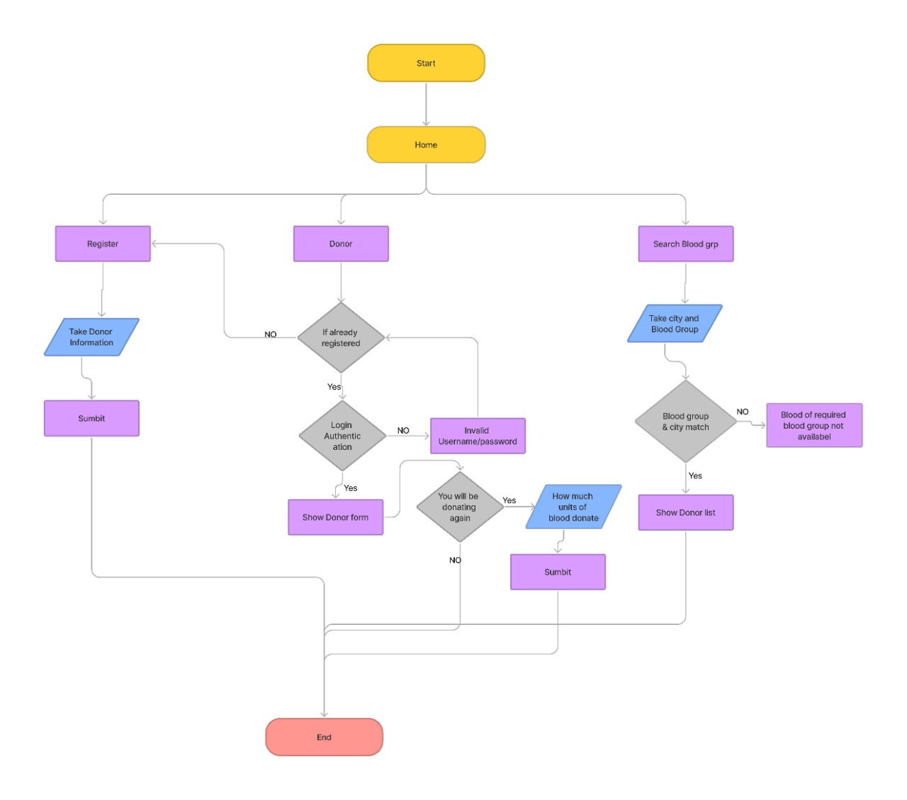

Slide 8
TECHNOLOGIES USED
Python
Python is a multi-paradigm programming language. Object-oriented programming and structured programming are fully supported, and many of their features support functional programming and aspect-oriented programming
Python GUI -Tkinter
Graphical User Interface(GUI) is a form of user interface which allows users to interact with computers. Tkinter is the inbuilt python module that is used to create GUI applications. It is one of the most commonly used modules for creating GUI applications in Python as it is simple and easy to work with. You don’t need to worry about the installation of the Tkinter module separately as it comes with Python already.
DB browser (SQLITE 3)
SQLite3 module is used to integrate the SQLite database with Python. It is a standardized Python DBI API 2.0 and provides a straightforward and simple-to-use interface for interacting with SQLite databases. There is no need to install this module separately as it comes along with Python after the 2.5x version.

Slide 9
SYSTEM OVERVIEW
Blood management system is a GUI based system that serving the users throughout the world
The main idea of a system is to manage blood so hospitals will able to provide blood to needy one’s.
Firstly, user’s need to create account by entering all basics information.
If user had already created his account, then Log-In.
If the user haven’t donated his blood , he need to fill the registration form in order to donate his/her blood.
Admin can perform operations like update, delete, search but user can only perform operation like register.
For more information user can navigate himself onto contact us.
In order to gain insights of our project user’s can navigate himself onto about us.

Slide 10
REFERENCES
https://www.geeksforgeeks.org/
https://www.javatpoint.com/

Slide 11
RESULT

Slide 12
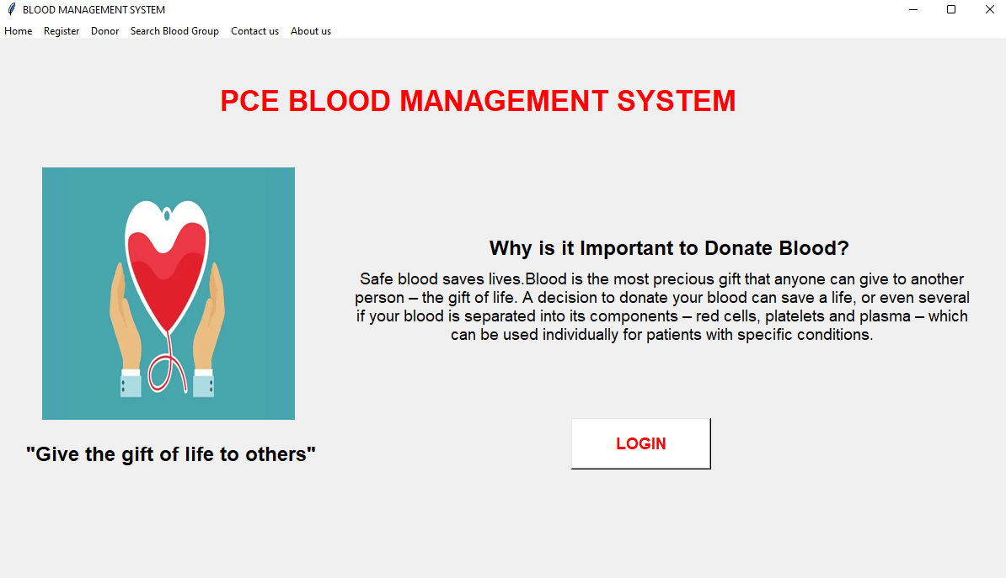
RESULT

Slide 13
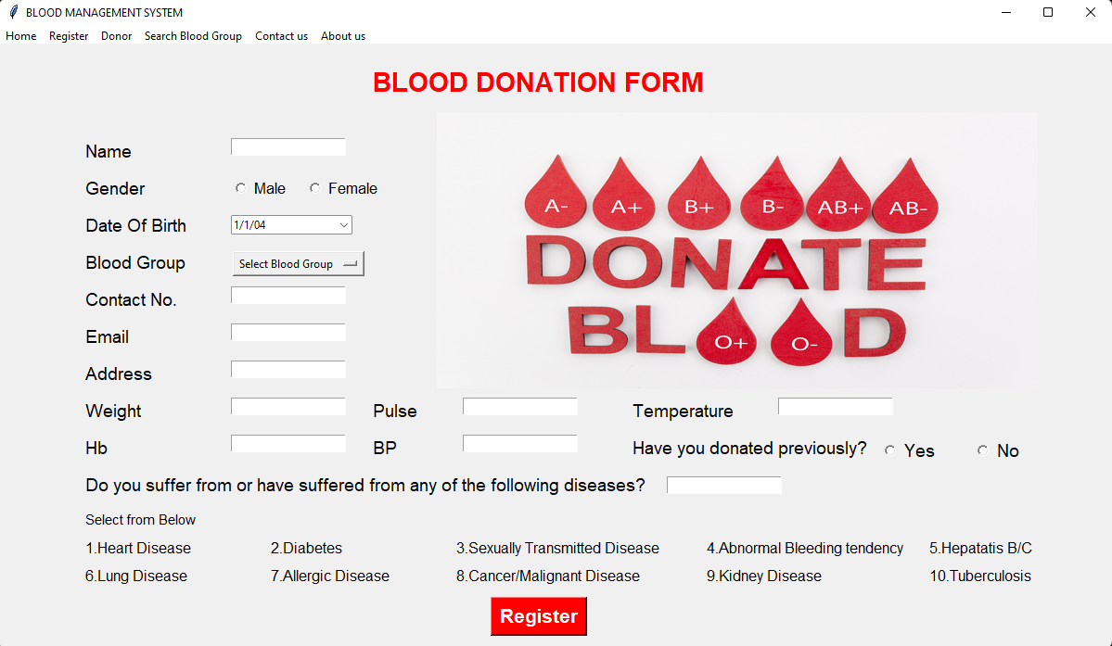

Slide 14
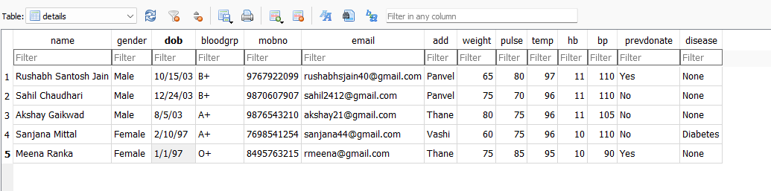
Database

Slide 15
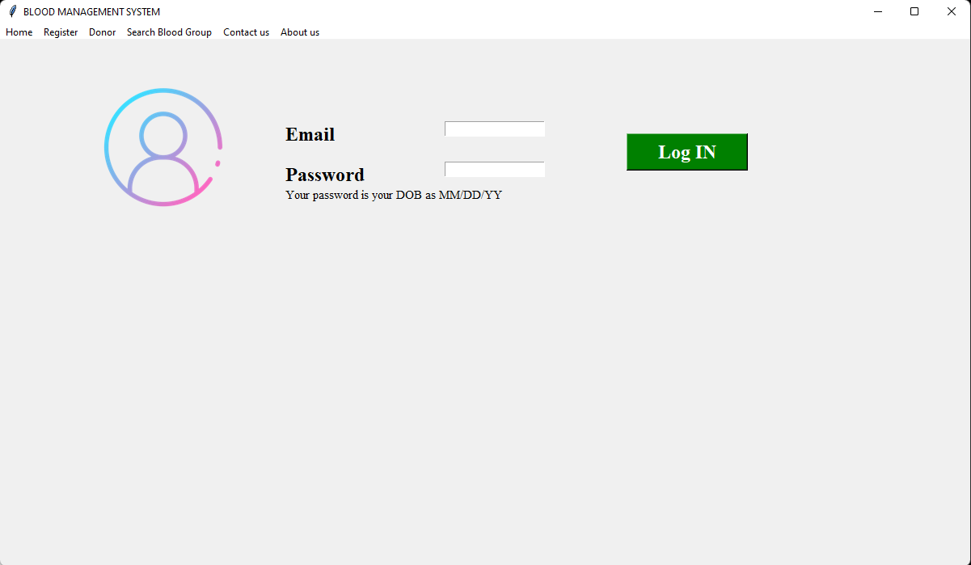

Slide 16
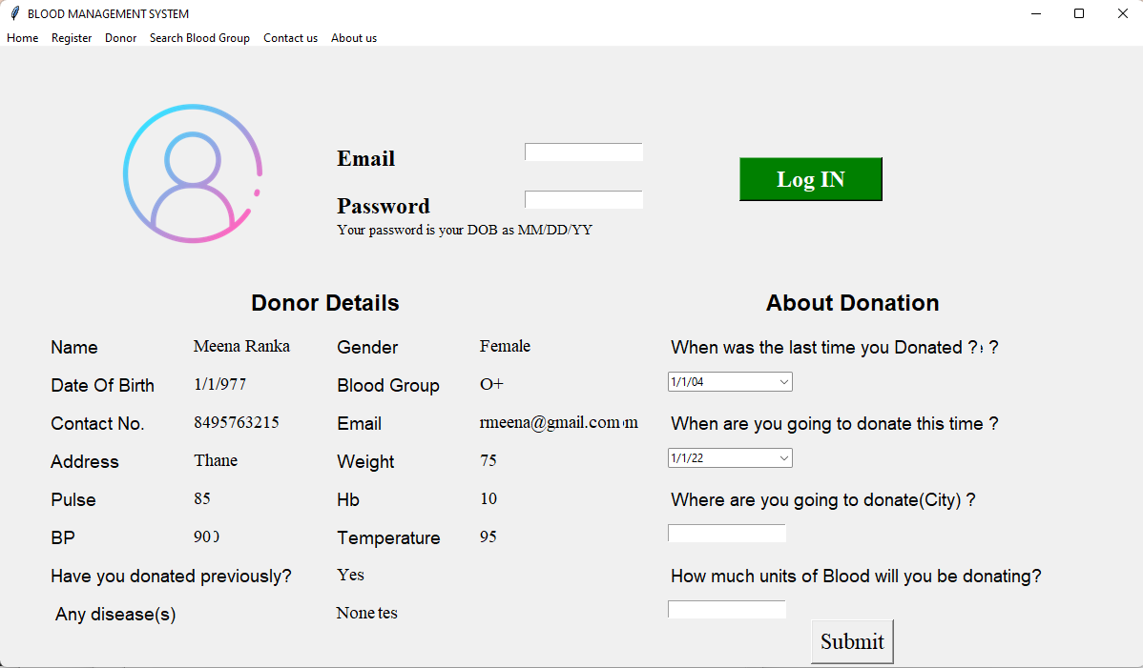
RESULT

Slide 17
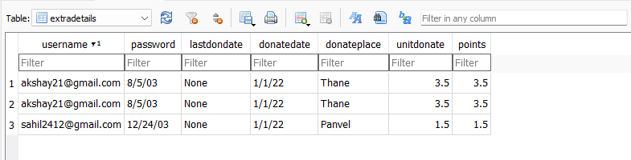
Database

Slide 18
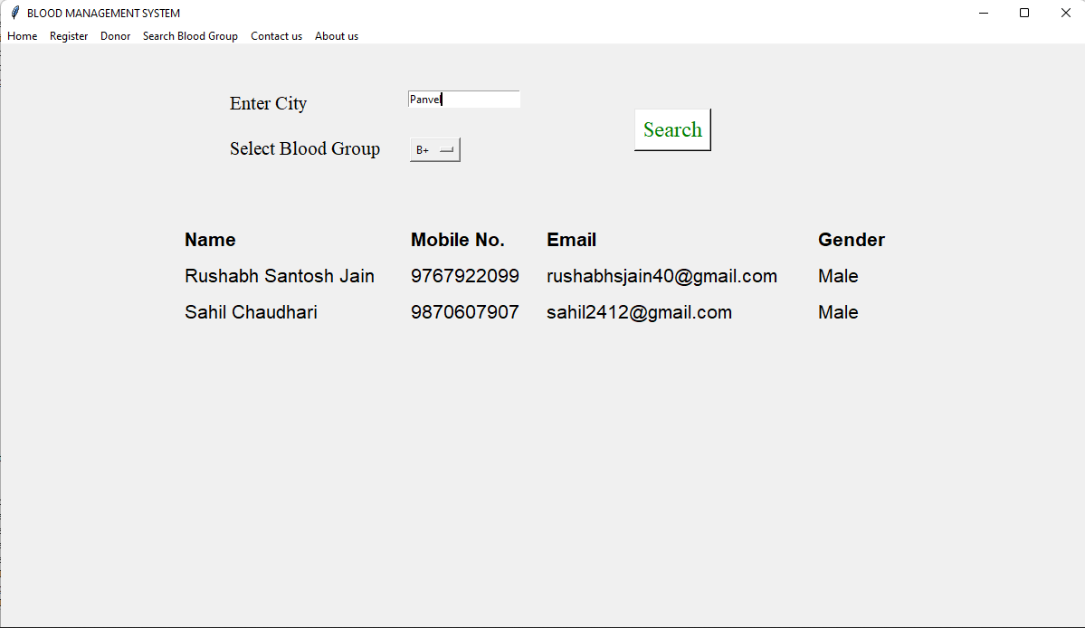

Slide 19
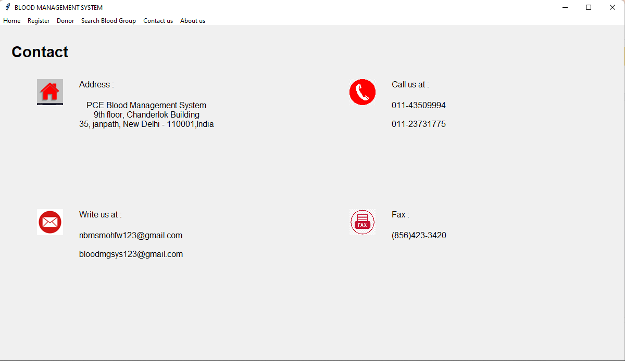

Slide 20
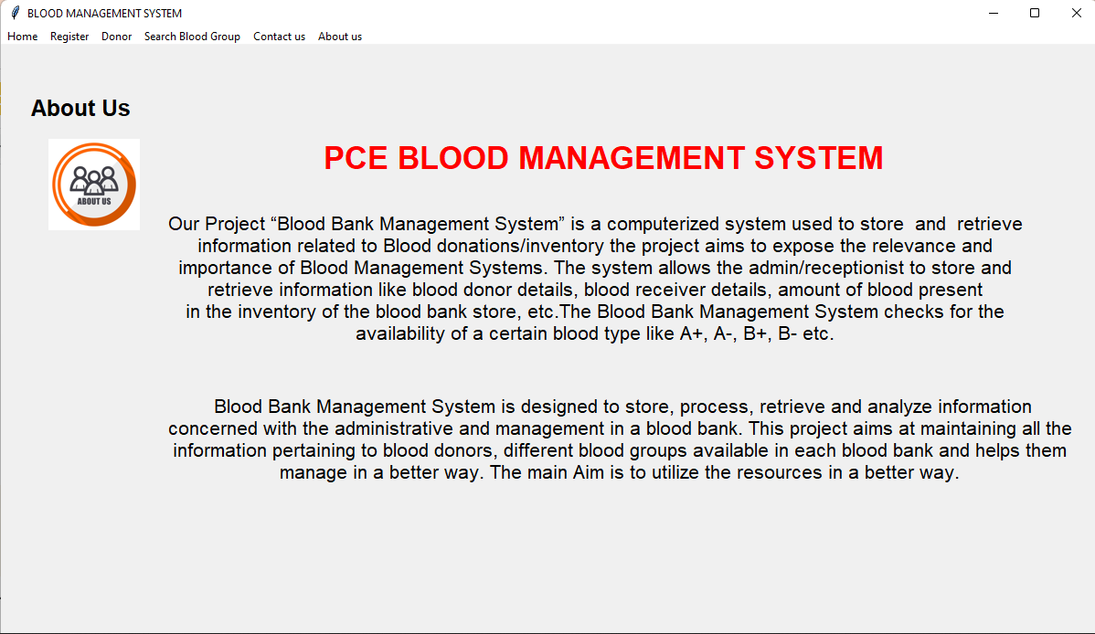
CONCLUSION

Slide 21
CONCLUSION
In this Project we made a blood management system with the help of python, Sqlite3.
Blood Management System lightens the manual work for the donor. It also reduces the paper work and data lost.

Slide 22
THANK YOU.

